Slide 1
US Mass Murder Predictions using Data Mining Techniques
Chetana
Davneet Kaur
Shaista Gulnaar

Slide 2
Outline
Introduction
1
Impact
2
Related Works
3
Proposed Predictions
4
Datasets
5
Data Cleaning
6
Results
7
Future Work
8

Slide 3
Introduction
398 mass shootings
1996 deaths and 2488 people injured
Childhood abuse, binge drinking, and male gender
Avg genocides is 7 per year which took 39 lives
48 person injuries per year

Slide 4
Impact
life and materials loss
people panic and racism.
mass gatherings and celebrations
effect on children , future generation
Reputation of a particular area

Slide 5
Related work
“Mental Illness, Mass Shootings, and the Politics of American Firearms”
By J. M. Metzl & K. T. MacLeish (2014).
“Rates of Household Firearm Ownership and Homicide Across US Regions and States, 1988–1997”
By M. Miller, D. Azrael & D. Hemenway (2012).

Slide 6
Proposed Predictions
Mental Illness in shooters based on their Age and Race
1
On which specific date’s attacks are more likely to occur at what states
2

Slide 7
Data Set
Data Set obtained from kaggle.com and opendatasoft.com
Attributes (in original data set - 12):
Title
Location
Date
Summary
Fatalities
Injured
Total Victims
Mental Health Issues
Race
Gender
Latitude
Longitude

Slide 8
Refined attributes
City
State
Month
DOM (dayOfMonth)
Age
Total Victims
Mental Health Issues
Race

Slide 9
Data Cleaning
Missing Values:
5.05 % total missing values
Age derived from summary & age in data set from opendatasoft.com
City & State derived from location, latitude & longitude
Month & DOM derived from Date

Slide 10
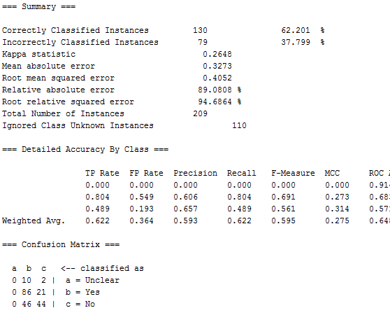
Results
Age, Race -> Mental Illness
Naïve Bayse:

Slide 11
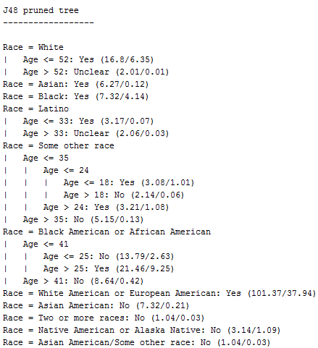
Results
Age, Race -> Mental Illness
J48

Slide 12

Results
Age, Race -> Mental Illness
J48

Slide 13
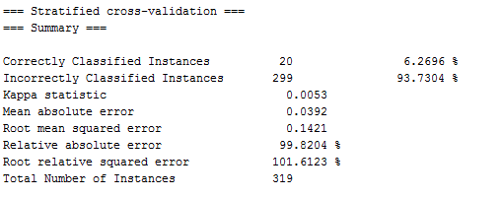
Results
Month, DOM -> State
Naïve Bayse

Slide 14
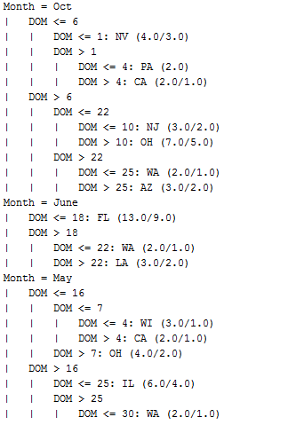
Results
Month, DOM -> State
J48

Slide 15
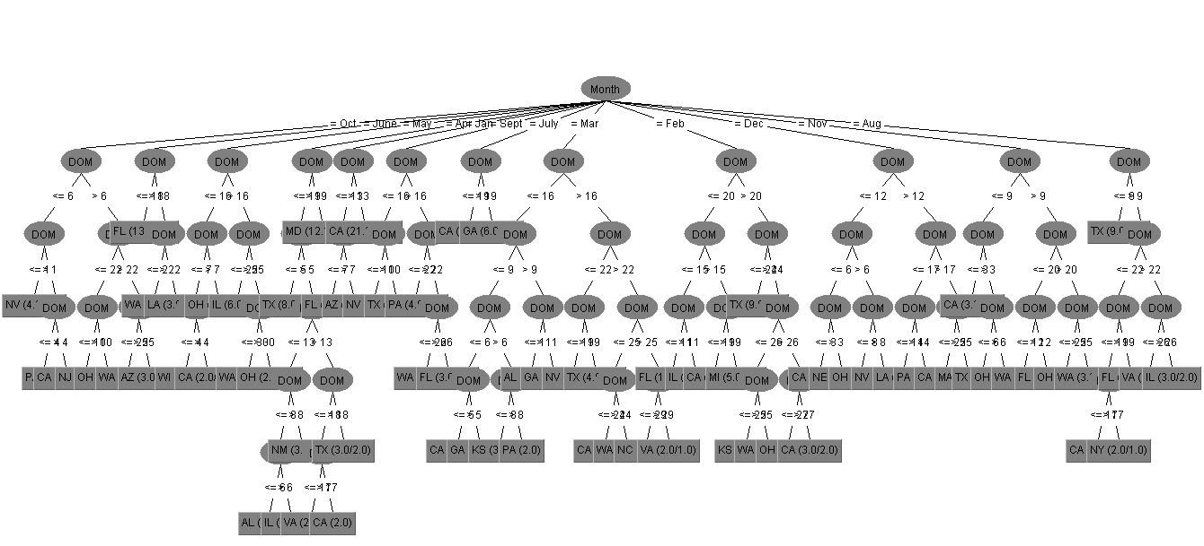
Results
Month, DOM -> State
J48

Slide 16
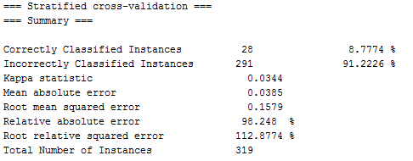
Results
Month, DOM -> State
J48

Slide 17

Future work
Dig more in “which states, attacks are more likely to occur”.
Age groups mostly involved in mass shootings in a particular state/city.

